Slide 1
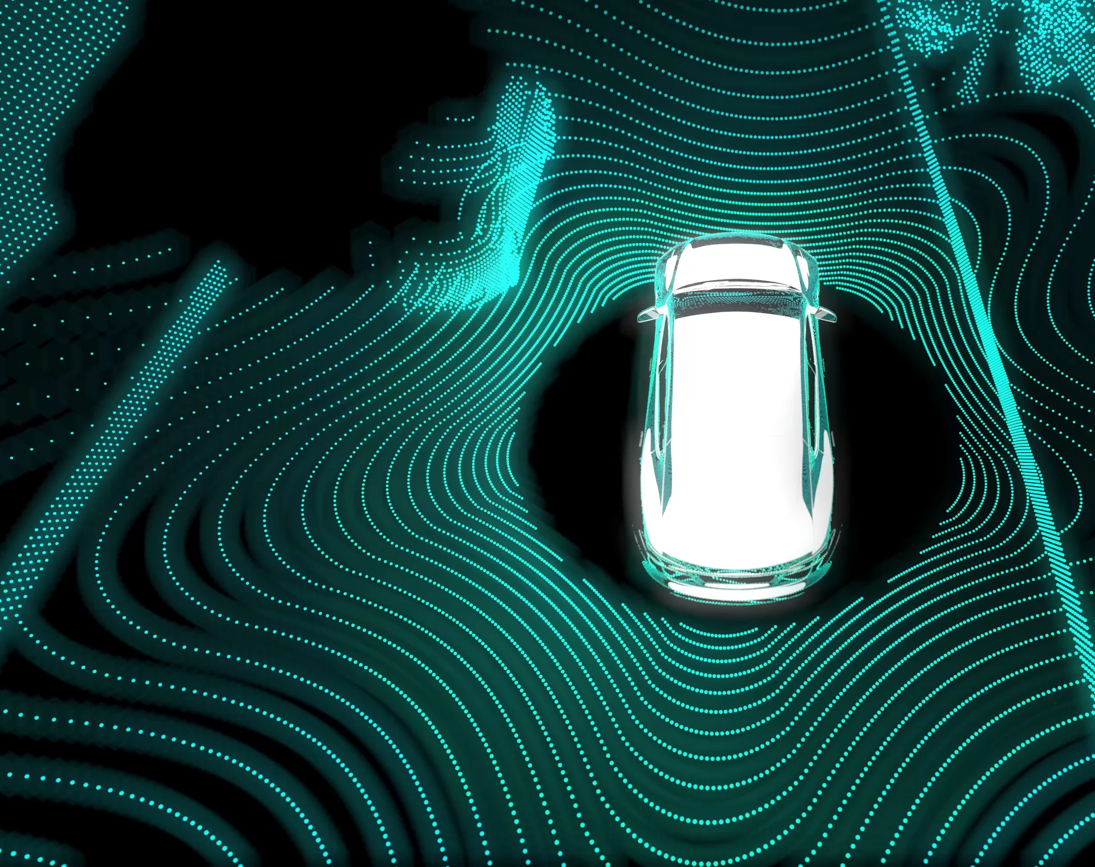

SOCIO-TECHNICAL PERSPECTIVE OF SELF-DRIVING CARS
GENC, ECE BEREN
2023-05-15
ANKARA
MIDDLE EAST TECHNICAL UNIVERSITY INFORMATICS INSTITUTE DEPARTMENT OF INFORMATION SYSTEMS

Slide 2
TRANSITION TO CONNECTED AND AUTONOMOUS VEHICLES
ROOT CAUSES OF TRANSITION:
Climate change
Low carbon transition
Road safety
Urbanisation
Comfort
Social inclusion
Efficiency
Environmental factors
Transition to smart cities
GENC, ECE BEREN SOCIO-TECHNICAL PERSPECTIVE OF SELF-DRIVING CARS 2023-05-15
1

Slide 3
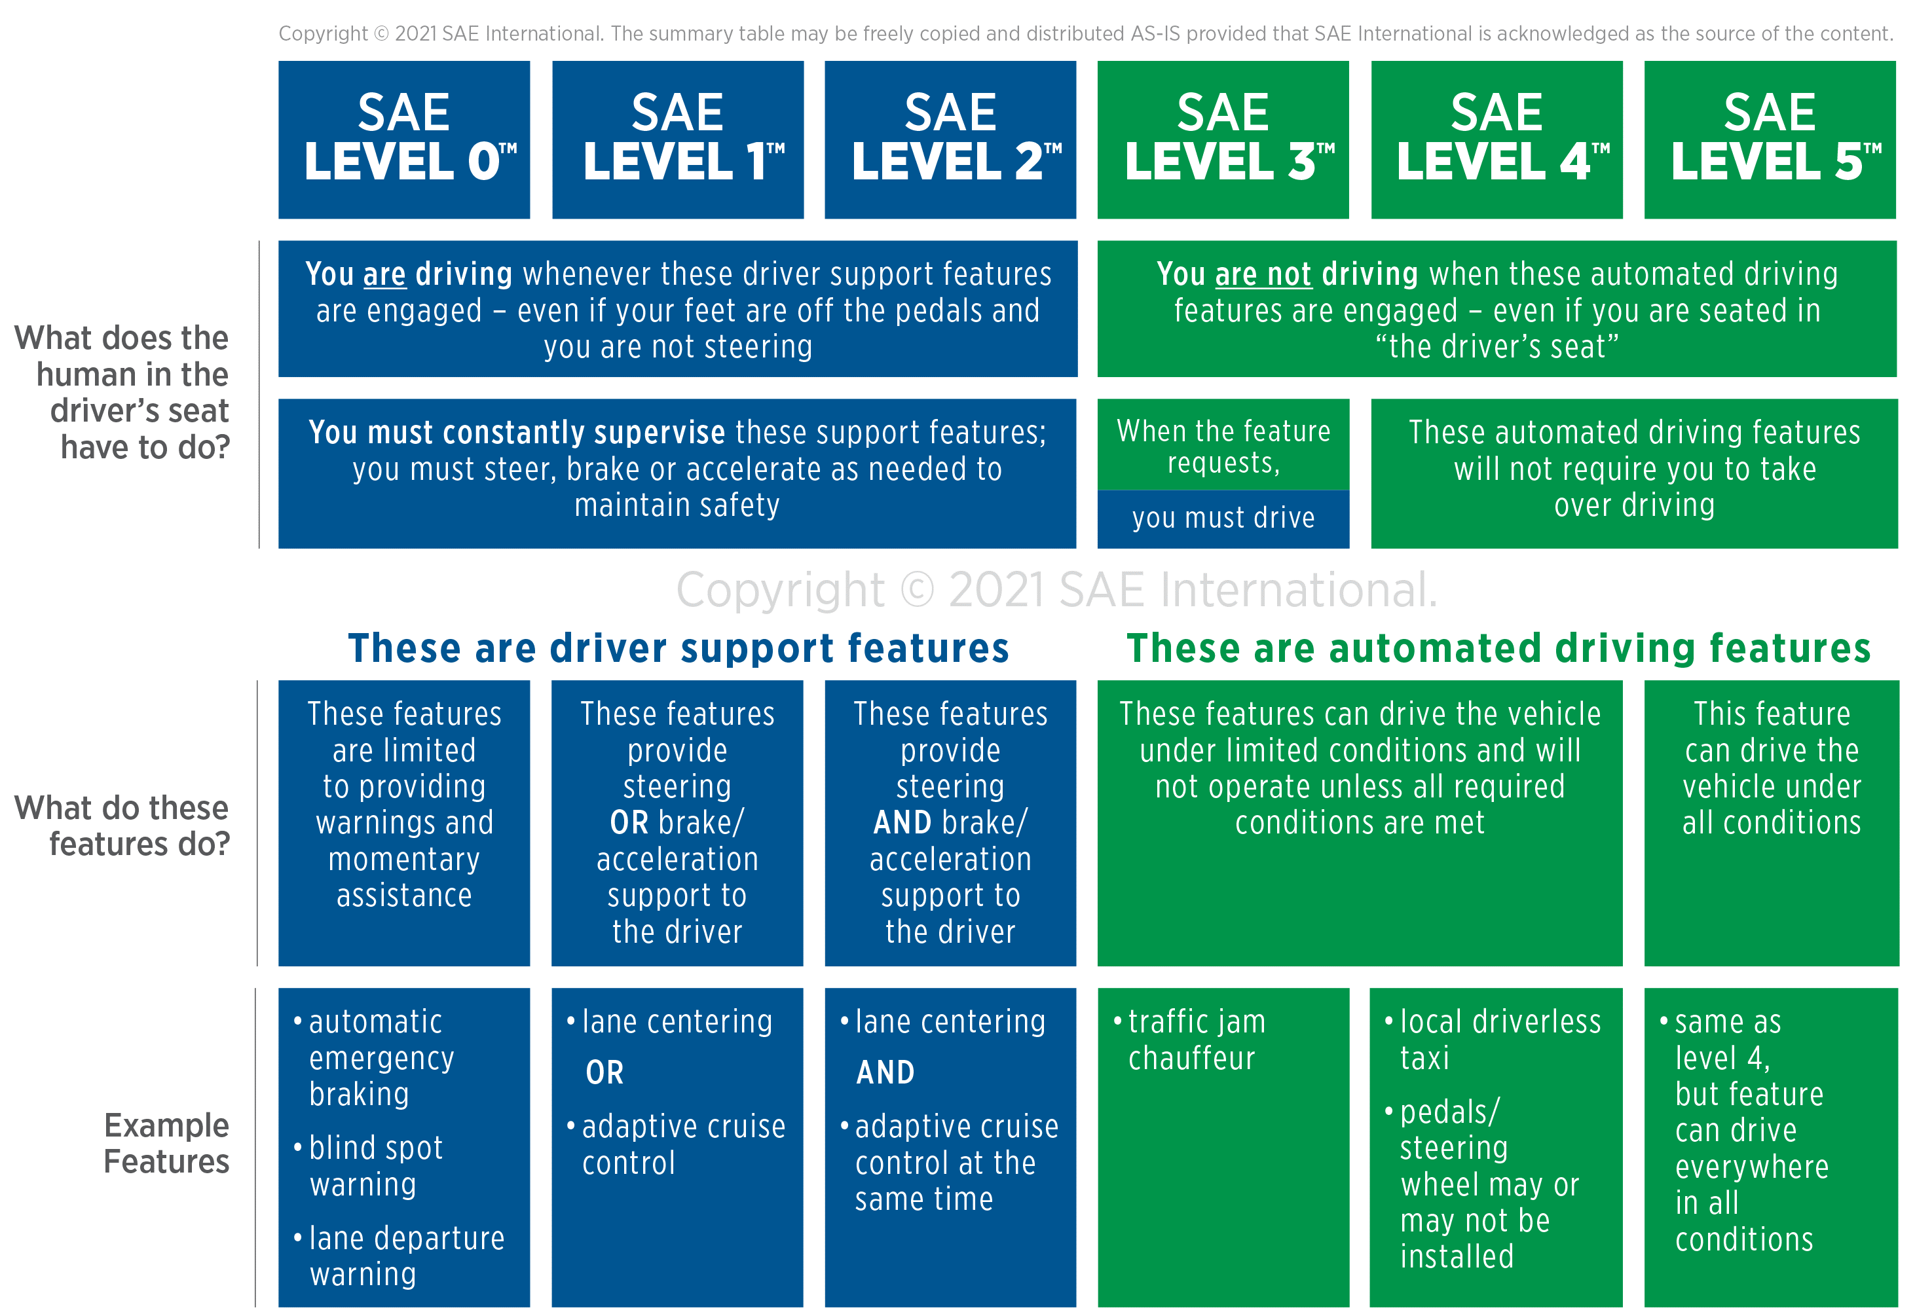
SAE J3016 LEVELS OF DRIVING AUTOMATION
Ref: SAE International Releases Updated Visual Chart for Its “Levels of Driving Automation” Standard for Self-Driving Vehicles, 2018-12-11, Warrendale, PA.
GENC, ECE BEREN SOCIO-TECHNICAL PERSPECTIVE OF SELF-DRIVING CARS 2023-05-15
2

Slide 4
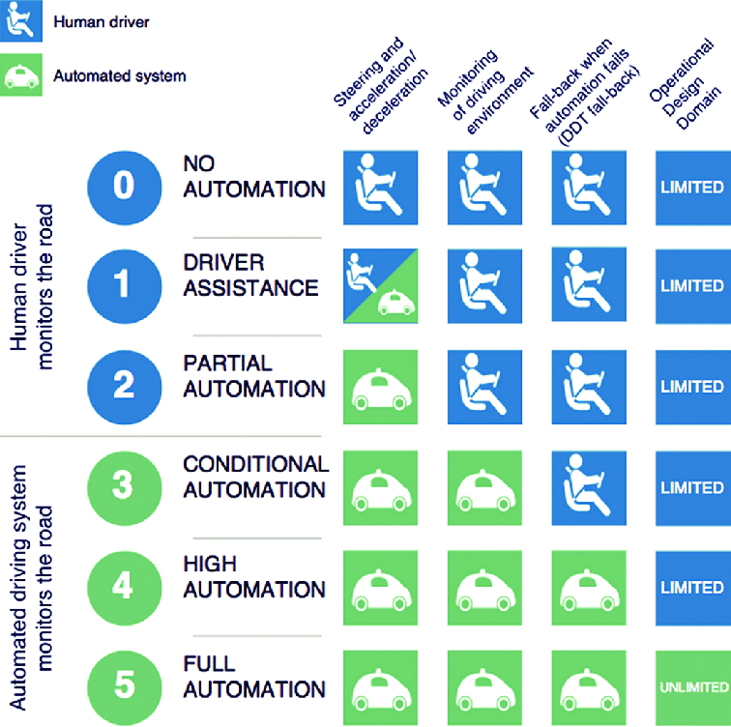
SAE J3016 LEVELS OF DRIVING AUTOMATION
Ref: SAE International Releases Updated Visual Chart for Its “Levels of Driving Automation” Standard for Self-Driving Vehicles, 2018-12-11, Warrendale, PA.
GENC, ECE BEREN SOCIO-TECHNICAL PERSPECTIVE OF SELF-DRIVING CARS 2023-05-15
3

Slide 5

HISTORY OF AUTONOMOUS VEHICLES
GENC, ECE BEREN SOCIO-TECHNICAL PERSPECTIVE OF SELF-DRIVING CARS 2023-05-15
4

Slide 6
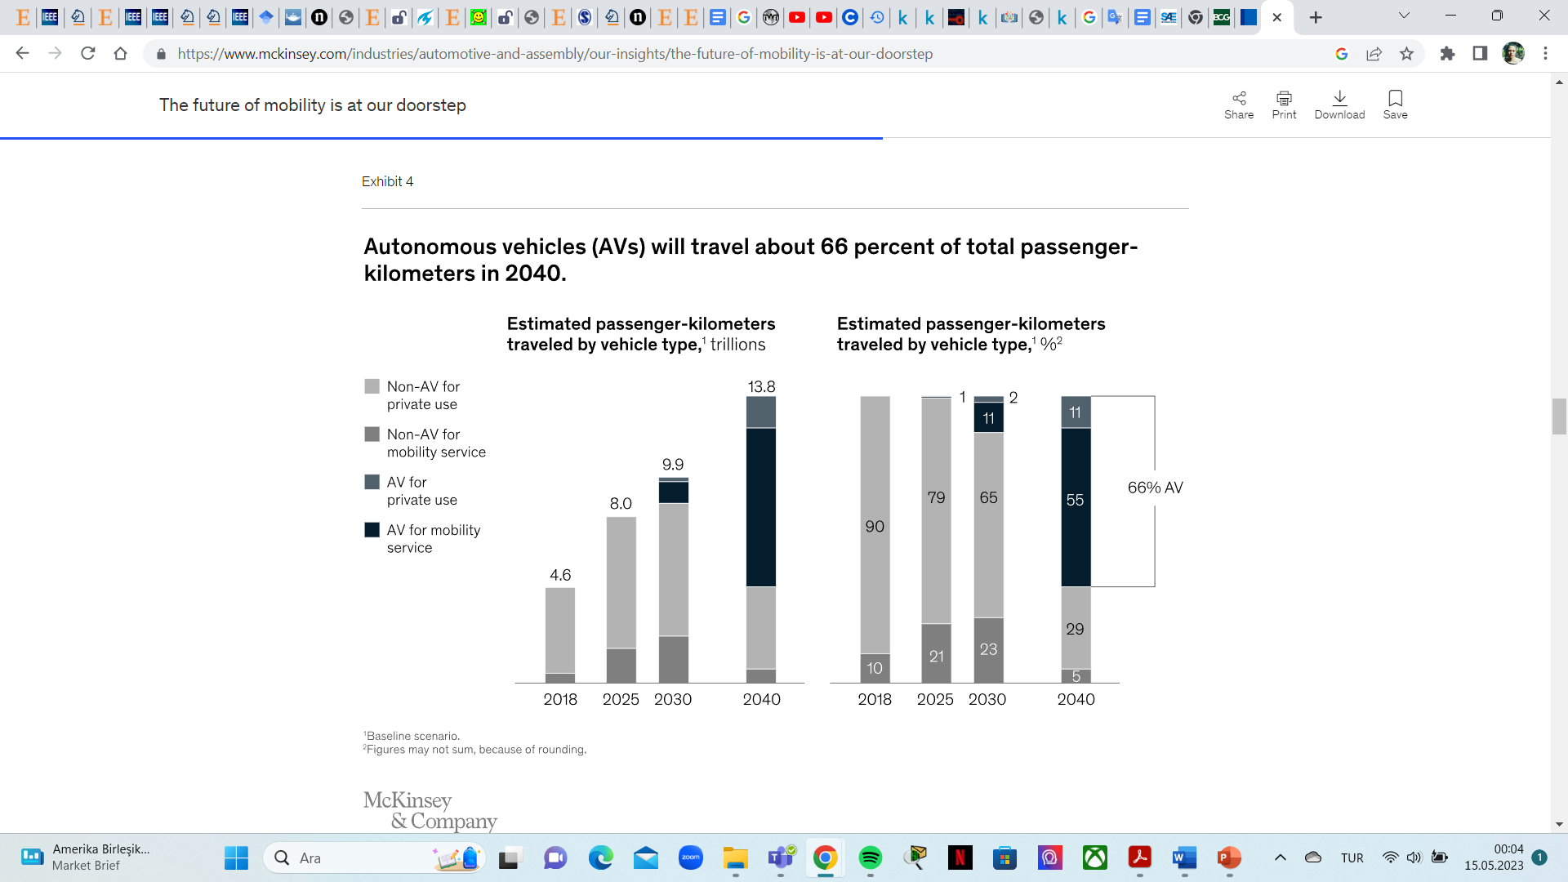
AUTONOMOUS VEHICLES MARKET PREDICTIONS
Ref: McKinsey, The future of mobility is at our doorstep. December 19, 2019 | Article.
GENC, ECE BEREN SOCIO-TECHNICAL PERSPECTIVE OF SELF-DRIVING CARS 2023-05-15
5

Slide 7
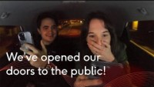
TODAY’S OF CONNECTED AND AUTONOMOUS VEHICLES
GENC, ECE BEREN SOCIO-TECHNICAL PERSPECTIVE OF SELF-DRIVING CARS 2023-05-15
6

Slide 8
SOCIAL CONSTRUCTION OF TECHNOLOGY
“[…] technology, of itself, has no power, does nothing. Only in association with human agency, social structures, and organizations does technology fulfill functions.” ( Geels, 2002).
GENC, ECE BEREN SOCIO-TECHNICAL PERSPECTIVE OF SELF-DRIVING CARS 2023-05-15
7

Slide 9
SOCIO-TECHNICAL PERSPECTIVE OF AUTONOMOUS VEHICLES
Technology and Scientific Knowledge
Policy
Market Rules
Civil Society & Consumers
Infrastructure
Industrial Networks
Cultural Symbolism of Cars
STAKEHOLDERS OF SUSTAINABLE TRANSITION
GENC, ECE BEREN SOCIO-TECHNICAL PERSPECTIVE OF SELF-DRIVING CARS 2023-05-15
8

Slide 10
SOCIO-TECHNICAL TRANSITION OF MOBILITY SYSTEM: AUTONOMOUS VEHICLES
LIMITED SET OF DIMENSIONS OF (UN)SUSTAINABILITY:
Neo-Classical Economists View:
Environmental problems as negative externalities resulting from market failures
Govermantal influences on incentives and frame conditions like taxes, emissions tradtrading
Policy discussions
Psychologists:
Focus on the attitude and behaviour of individuals
Policy recommendations that highlight information provision and education campaigns
Deep Ecologists:
Environmental problems to the failures of modernism
Cultural change towards eco-centrist approaches
Green values, localism and self-sufficiency
GENC, ECE BEREN SOCIO-TECHNICAL PERSPECTIVE OF SELF-DRIVING CARS 2023-05-15
9

Slide 11
SOCIO-TECHNICAL TRANSITION OF MOBILITY SYSTEM: AUTONOMOUS VEHICLES
LIMITED SET OF DIMENSIONS OF (UN)SUSTAINABILITY:
Engineers:
Science and technology
Advocate clean technology, eco-efficiency
Political Scientists:
Study the development and struggles over formal goals and targets
E.g. Kyoto, Millennium Development Goals
Goals -> Regulations and Policy Programs-> Implementations -> Control
Environmental Management Standards
Evironmental impact assessments
GENC, ECE BEREN SOCIO-TECHNICAL PERSPECTIVE OF SELF-DRIVING CARS 2023-05-15
10

Slide 12
SOCIO-TECHNICAL TRANSITION OF MOBILITY SYSTEM: AUTONOMOUS VEHICLES
‘‘The continuing need for transport research to embrace multiple perspectives to understand the complexities of modern mobility’’ (Pangbourne and Anable, 2011, p. 1535).
GENC, ECE BEREN SOCIO-TECHNICAL PERSPECTIVE OF SELF-DRIVING CARS 2023-05-15
11

Slide 13
THE SOCIO-TECHNICAL SYSTEMS STACK
Society: Laws, regulation and culture
Organization
Business Process
Application System
Communications and Data Management
Operating System
Equipment: Hardware devices
Ref: Ian Sommerville-Socio-Technical Systems Course
GENC, ECE BEREN SOCIO-TECHNICAL PERSPECTIVE OF SELF-DRIVING CARS 2023-05-15
12

Slide 14
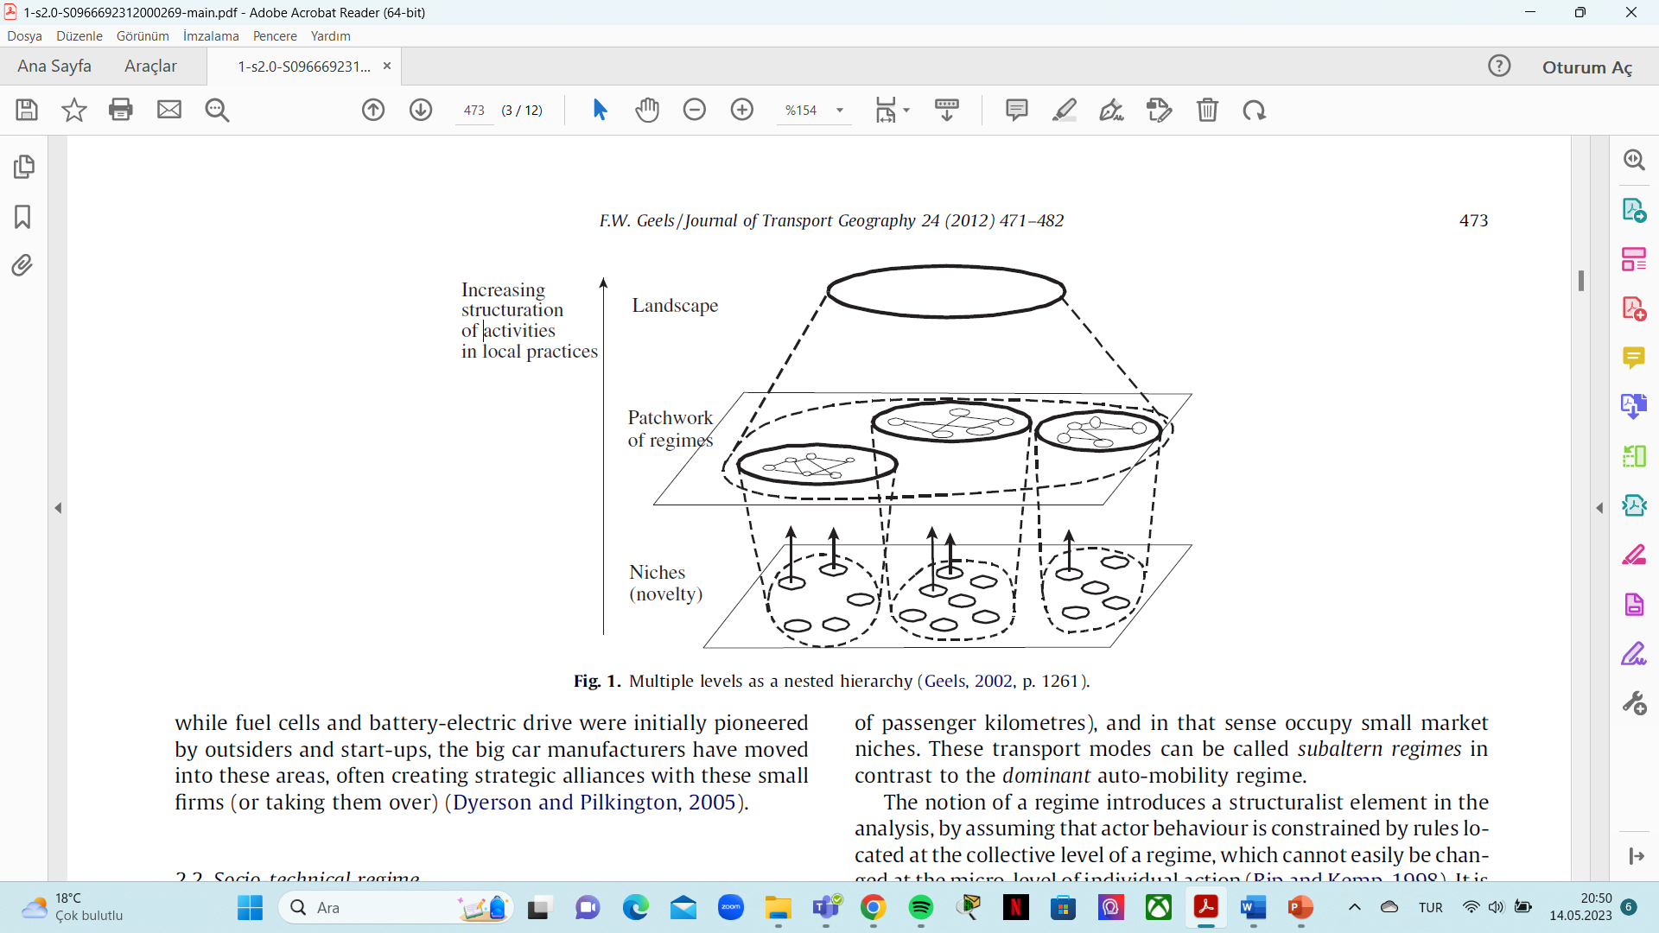
SOCIO-TECHNICAL TRANSITION TO AUTONOMOUS VEHICLES
Ref: Geels, F.W. (2002). Technological Transitions As Evolutionary Reconfiguration Processes: A Multi-level Perspective And A Case-Study. Research Policy, 31 (8–9), 1257–1274.
GENC, ECE BEREN SOCIO-TECHNICAL PERSPECTIVE OF SELF-DRIVING CARS 2023-05-15
13

Slide 15
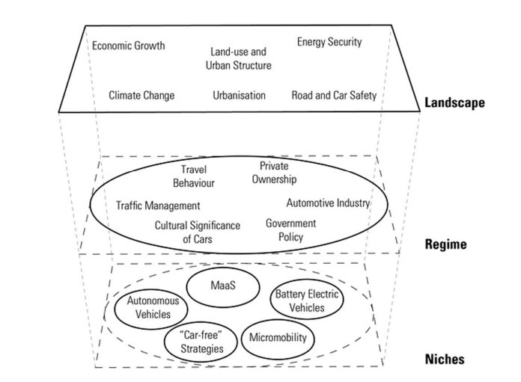
SYSTEM OF AUTOMOBILITY
Ref: Geels, F.W. (2002). Technological Transitions As Evolutionary Reconfiguration Processes: A Multi-level Perspective And A Case-Study. Research Policy, 31 (8–9), 1257–1274.
GENC, ECE BEREN SOCIO-TECHNICAL PERSPECTIVE OF SELF-DRIVING CARS 2023-05-15
14

Slide 16
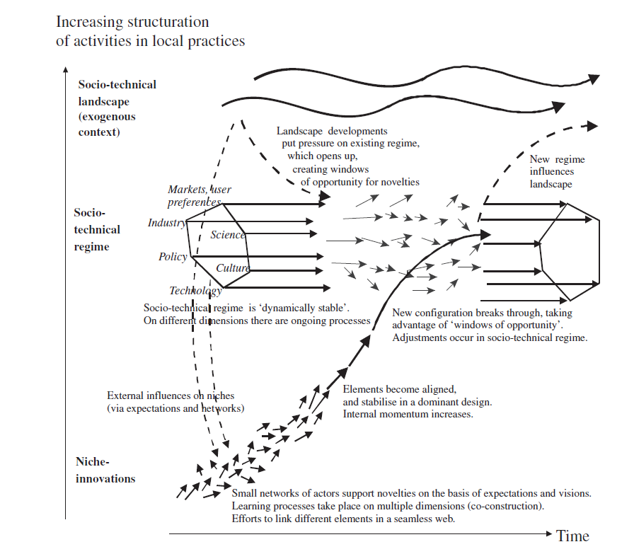
MULTI LEVEL PERSPECTIVE OF TRANSITION TO AUTONOMOUS VEHICLES
Ref: Geels, F. W. (2012). A Socio-Technical Analysis of Low-carbon Transitions: Introducing The Multi-level Perspective Into Transport Studies. Journal of Transport Geography, 24, 471–482.
GENC, ECE BEREN SOCIO-TECHNICAL PERSPECTIVE OF SELF-DRIVING CARS 2023-05-15
15

Slide 17
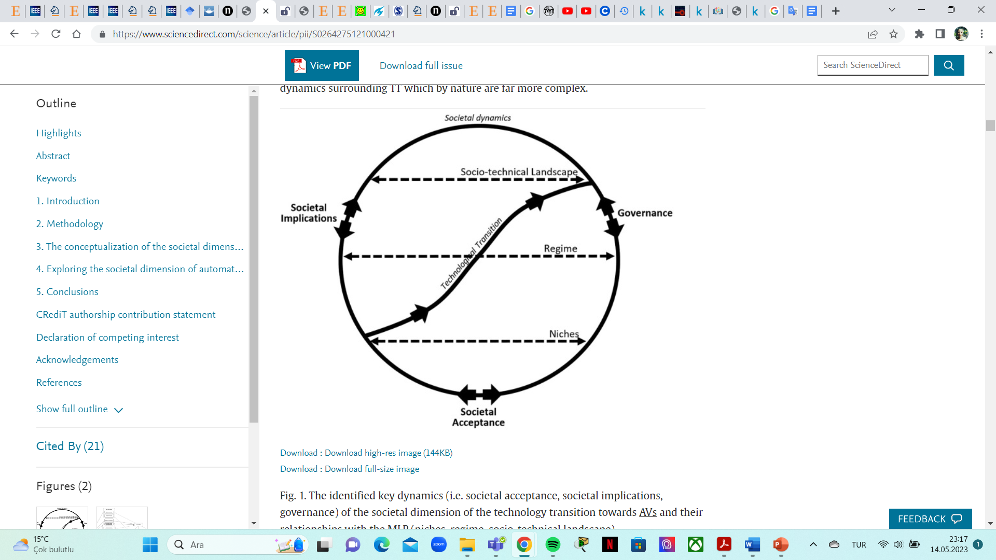
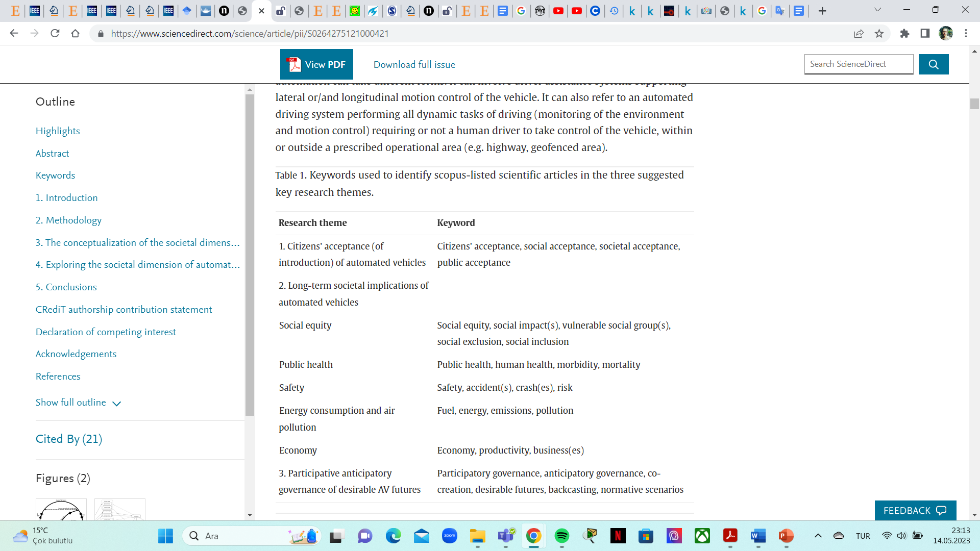
SOCIAL CONSTRUCTION OF TECHNOLOGY
Ref: Millakis, D., Müller, S. (2021). The Societal Dimension Of The Automated Vehicles Transition: Towards A Research Agenda. Cities, 113.
GENC, ECE BEREN SOCIO-TECHNICAL PERSPECTIVE OF SELF-DRIVING CARS 2023-05-15
16

Slide 18
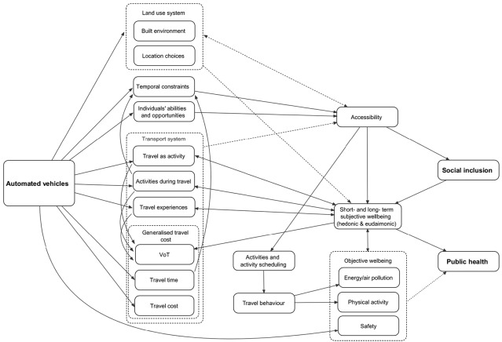
SOCIAL CONSTRUCTION OF TECHNOLOGY
Ref: Millakis, D., Müller, S. (2021). The Societal Dimension Of The Automated Vehicles Transition: Towards A Research Agenda. Cities, 113.
GENC, ECE BEREN SOCIO-TECHNICAL PERSPECTIVE OF SELF-DRIVING CARS 2023-05-15
17

Slide 19
CASE: DEVELOPMENT AND TRANSPORT IMPLICATIONS OF AUTOMATED VEHICLES IN THE NETHERLANDS: SCENARIOS FOR 2030 AND 2050
Research Questions:
What are the possible developments for automated vehicles and which factors will determine these developments on a time horizon up to 2030 and 2050 in the Netherlands?
What stages can be distinguished in this development?
What are the implications for road capacity?
Does this differ between urban roads, regional roads and motorways?
What are the implications for users (value of time) and consequently for travel behaviour?
To what extent might automated vehicles affect transport planning?
GENC, ECE BEREN SOCIO-TECHNICAL PERSPECTIVE OF SELF-DRIVING CARS 2023-05-15
18

Slide 20
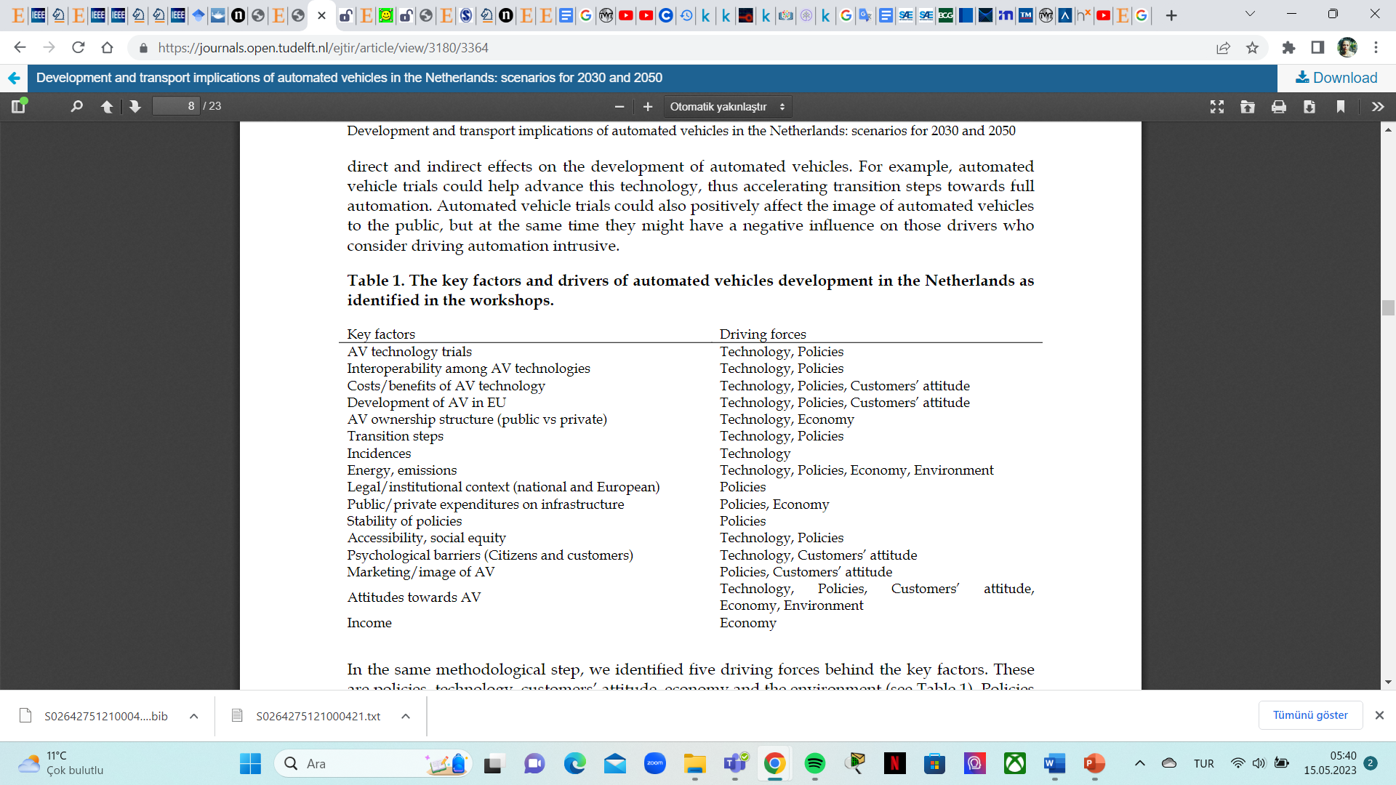
CASE: DEVELOPMENT AND TRANSPORT IMPLICATIONS OF AUTOMATED VEHICLES IN THE NETHERLANDS: SCENARIOS FOR 2030 AND 2050
Ref: Milakis, D., Snelder, M., Arem, B. van, Wee, B. van, & Homem de Almeida Correia, G. (2017). Development and transport implications of automated vehicles in the Netherlands: scenarios for 2030 and 2050. European Journal of Transport and Infrastructure Research, 17(1).
GENC, ECE BEREN SOCIO-TECHNICAL PERSPECTIVE OF SELF-DRIVING CARS 2023-05-15
19

Slide 21
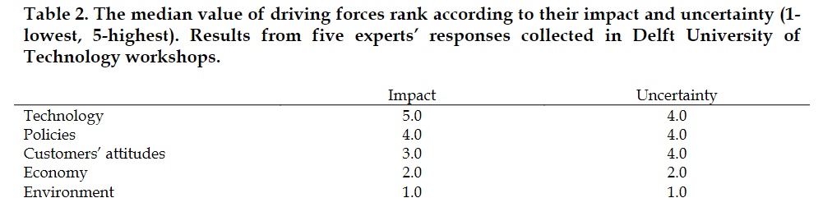
CASE: DEVELOPMENT AND TRANSPORT IMPLICATIONS OF AUTOMATED VEHICLES IN THE NETHERLANDS: SCENARIOS FOR 2030 AND 2050
Ref: Milakis, D., Snelder, M., Arem, B. van, Wee, B. van, & Homem de Almeida Correia, G. (2017). Development and transport implications of automated vehicles in the Netherlands: scenarios for 2030 and 2050. European Journal of Transport and Infrastructure Research, 17(1).
GENC, ECE BEREN SOCIO-TECHNICAL PERSPECTIVE OF SELF-DRIVING CARS 2023-05-15
20

Slide 22
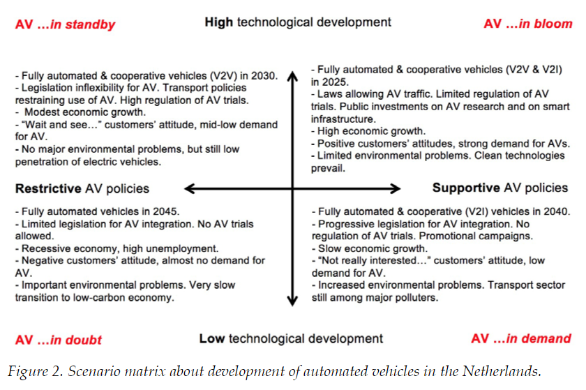
CASE: DEVELOPMENT AND TRANSPORT IMPLICATIONS OF AUTOMATED VEHICLES IN THE NETHERLANDS: SCENARIOS FOR 2030 AND 2050
Ref: Milakis, D., Snelder, M., Arem, B. van, Wee, B. van, & Homem de Almeida Correia, G. (2017). Development and transport implications of automated vehicles in the Netherlands: scenarios for 2030 and 2050. European Journal of Transport and Infrastructure Research, 17(1).
GENC, ECE BEREN SOCIO-TECHNICAL PERSPECTIVE OF SELF-DRIVING CARS 2023-05-15
21

Slide 23
CASE: DEVELOPMENT AND TRANSPORT IMPLICATIONS OF AUTOMATED VEHICLES IN THE NETHERLANDS: SCENARIOS FOR 2030 AND 2050
Findings:
Fully automated vehicles are expected to be commercially available within a time window of twenty years (between 2025 and 2045), while the respective time-window for conditional automation is smaller (ten years) and more immediate (between 2018 and 2028),
Public (national, EU) and private (OEMs) R&D investments, progressive regulatory frameworks (e.g. trials, subsidies) as well as increased customers’ demand could accelerate transition from conditionally to fully automated vehicles,
Full vehicle automation is expected to be a game changer, driving the demand for automated vehicles to a high point. Penetration rates of automated vehicles on the market are expected to vary among different scenarios between 1% and 11% (mainly conditionally automated vehicles) in 2030 and between 7% and 61% (mainly fully automated vehicles) in 2050,
GENC, ECE BEREN SOCIO-TECHNICAL PERSPECTIVE OF SELF-DRIVING CARS 2023-05-15
22

Slide 24
CASE: DEVELOPMENT AND TRANSPORT IMPLICATIONS OF AUTOMATED VEHICLES IN THE NETHERLANDS: SCENARIOS FOR 2030 AND 2050
Findings:
Vehicle automation and cooperation are expected to follow converging evolution paths. The type of cooperation (V2I, V2V) will likely vary among different scenarios according to the main drivers (policies, technological development),
Complexity of urban environment is expected to influence the development path of automated vehicles either by inducing regulation allowing automated vehicles to travel only on motorways or by complicating and subsequently delaying technological development in this field,
Unexpected incidents like fatal accidents; bankruptcy or change in strategic priorities of major industry players could significantly influence the development path for automated vehicles in the Netherlands, •development of automated vehicles is expected to have implications on mobility in all scenarios. These implications vary from very important in the ‘AV ...in bloom’ scenario to minimal in the ‘AV ...in doubt’ scenario,
GENC, ECE BEREN SOCIO-TECHNICAL PERSPECTIVE OF SELF-DRIVING CARS 2023-05-15
23

Slide 25
REFERENCES
Geels, F.W. (2002). Technological Transitions As Evolutionary Reconfiguration Processes: A Multi-level Perspective And A Case-Study. Research Policy, 31 (8–9), 1257–1274.
Geels, F. W. (2012). A Socio-Technical Analysis of Low-carbon Transitions: Introducing The Multi-Level Perspective Into Transport Studies. Journal of Transport Geography, 24, 471–482.
Ian Sommerville-Socio-Technical Systems Course
Martin, R. (2021). AV Futures Or Futures With Avs? Bridging Sociotechnical İmaginaries And A Multi-level Perspective Of Autonomous Vehicle Visualisations İn Praxis. Humanities and Social Sciences Communİcations, 8(68).
Millakis, D., Müller, S. (2021). The Societal Dimension Of The Automated Vehicles Transition: Towards A Research Agenda. Cities, 113.
Milakis, D., Snelder, M., Arem, B. van, Wee, B. van, & Homem de Almeida Correia, G. (2017). Development and transport implications of automated vehicles in the Netherlands: scenarios for 2030 and 2050. European Journal of Transport and Infrastructure Research, 17(1).
SAE International Releases Updated Visual Chart for Its “Levels of Driving Automation” Standard for Self-Driving Vehicles, 2018-12-11, Warrendale, PA.
Pangbourne, K., Anable, J. (2011). Alternative Travel Futures: Guest Editorial. Journal of Transport Geography, 19 (6), pp. 1535-1537.
McKinsey The Future of Mobility is at Our Doorstep. December 19, 2019 | Article.
https://youtu.be/Pa6uCew5TWs (Last Access: 2023-05-14).
https://youtu.be/qUTTAWGmFeI (Last Access: 2023-05-14).
GENC, ECE BEREN SOCIO-TECHNICAL PERSPECTIVE OF SELF-DRIVING CARS 2023-05-15
24

